Slide 1
Cloud Based Learning An Introduction to Google Drive
Technology Professional Development Sessions
October 29th, 2014
3:00 – 4:00
4:00 – 5:00

Slide 2
Today’s Objectives
Cloud Storage: What is it? What are the benefits of storing information on the cloud?
Google Drive: Introduction to free features…
Google Docs
Google Slides
Google Spreadsheets
Google Forms
Google Drawing

Slide 3
What is cloud storage?
Online file storage centers or cloud storage providers that allow you to safely upload your files to the Internet.
There are various providers of cloud storage
Examples:
Apple iCloud
Dropbox
Amazon Cloud Drive
Microsoft SkyDrive
Google Drive

Slide 4
How do you use Google?
Google has many free resources available, which often go underutilized.

Slide 5
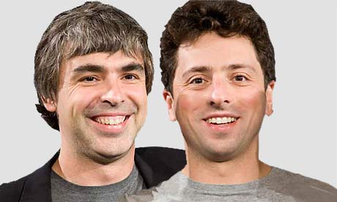
The Beginning
The purpose of inventing Google was to organize the world's information and make it universally accessible and useful.
Founded by Larry Page and Sergey Brin on September 7, 1998.

Slide 6
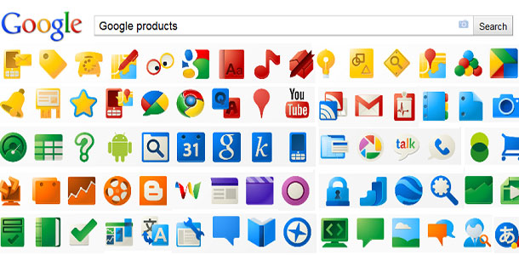
Now

Slide 7
Google Drive
Gives you 15GB of free storage.
Requires a G-mail account to be accessed.
Individuals can buy more storage for themselves (Google Apps for Business Administrators can buy storage licenses).
Allows you to create, upload, save, and share documents, spreadsheets, presentations, and more.

Slide 8
Going Google with Google Drive

Slide 9
What is Google Drive?
Google Docs is Google's web-based office suite.
Google Docs and MS Office each have their benefits and drawbacks.
- Google Docs offers free access, free online storage, and a number of collaborative features.
- MS Office remains the most widely used office suite, has numerous features that Google Docs does not, and offers much more support and training opportunities.
In response to Google Docs, MS launched SkyDrive, a web-based, stripped-down version of MS Office.

Slide 10
What is Google Drive?
Store and access files from any device.
Share and collaborate with others online.
Utilize various Google Apps along with your Google Drive.
Create one account that will allow you to use a plethora of web applications and web 2.0 tools.

Slide 11
What is Google Drive?
In Google Drive, you can create:
- Documents
- Presentations
- Spreadsheets
- Surveys / Quizzes
- Drawings

Slide 12
Creating Your Google Account & Using Google Drive

Slide 13
Review – Questions?
Cloud Storage: Online file storage centers or cloud storage providers that allow you to safely upload your files to the Internet.
Google Drive offers the following:
Google Docs
Google Slides
Google Spreadsheets
Google Forms
Google Drawing

